Slide 1
Hands-On: Solid Edge Automation
Jason Newell, Applications Architect, The Charles Machine Works, Inc.

Slide 2
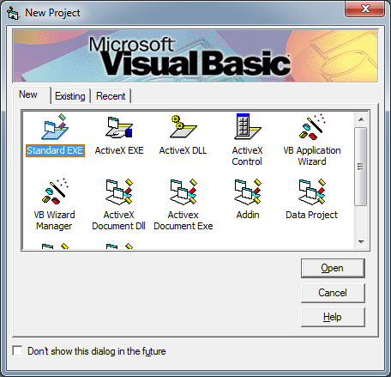
Solid Edge Automation
It used to be a lot easier…

Slide 3
Solid Edge Automation
It did used to be easier but things change. Change is constant in technology. We can certainly do everything in .NET that we did back then, plus a whole lot more. What’s the catch? We have to learn the new technologies and apply them to what we’re trying to do. Easier said than done but not impossible.
Fortunately, was have members of the community that are willing to figure out the hard stuff and show us the way. github.com/SolidEdgeCommunity. GitHub is the place to go to get modern examples of how to automate Solid Edge with current technologies. The majority of the material in this session was gleaned from GitHub.
We will also be using the github.com/SolidEdgeCommunity/SolidEdgeContrib library by installing the corresponding NuGet package into our project. This library makes automating Solid Edge with .NET much easier.

Slide 4
Single biggest challenge in .NET
Hands down, the single biggest challenge in automating Solid Edge with .NET is the fact that we have to deal with an “Interop Layer” between COM & .NET. COM is based off deterministic releasing of objects. i.e. When I say I’m done with an object, I’m done. .NET is a non-deterministic garbage collection (GC) technology which makes it VERY difficult to release COM objects in a timely manner.
There many articles about this topic. Admittedly, .NET has gotten much better as a technology in handling COM Interop. Also, Solid Edge has gotten much more forgiving in recent releases. The currently releases of Solid Edge expect this issue and does everything it can to prevent issues. Still though, there are issues. We have to do our part in doing everything we can to prevent a crash.
I have almost 15 years experience dealing with this problem and have developed my own solution that if implemented correctly, works flawless. It’s more work to code, but well worth the effort.

Slide 5
.NET Application Domains (AppDomain)
Every .NET process has a “default” AppDomain. This AppDomain gets created by the runtime when the process starts. Everything the process does lives inside this default AppDomain, including runtime callable wrappers (RCW). RCWs are our best friends and our worst enemies at the same time. It is the RCWs that linger after we done, holding on to COM references and ultimately cause Solid Edge to crash.
The key to this puzzle is the fact that we do have the option to create a new, isolated AppDomain to execute our Interop code inside. When we’re done, we simply unload the AppDomain, forcing everything inside of it to free every resource allocated inside it.

Slide 6
AppDomains
Process1
Default
AppDomain
Isolated
AppDomain
Process2
Default
AppDomain
Isolated
AppDomain
Process3
Default
AppDomain
Isolated
AppDomain

Slide 7
Hands on

